Slide 1
CSC 167 – Game 2 Fall for Fun
Written, Designed and Created By:
Chris Lewchuk
Ross Gordon-Baker
Peter Lebo
Jarrod Ferguson

Slide 2
Why are we Falling for Fun?
It is the day before Frank Fallsington’s wedding, and his friends decide to take him out sky-diving. So what’s the problem here? The boys have had a few too many wobbly pops, and forget to strap up Frank’s parachute before pushing him out of the plane. If Frank wants to be alive to attend his own wedding, he better hit every object in the sky to slow him down enough before hitting the ground.

Slide 3
Gameplay
Arrow keys to move
Hit birds to slow you down a small amount
Grab balloons to permanently slow you down
Avoid helicopters, or Frank won’t have a wedding
Keep an eye on your speedometer and altimeter- make sure to keep your speed low when approaching the ground
Keep an eye out for the Blimp- it will stop Frank and allow you to organize your next move
Terminal velocity included, lowered with every balloon you grab

Slide 4

Birds
Slow you down a small amount
Move side to side
Very common

Slide 5

Helicopters
Kill you instantly
Only Vertical movement
Common

Slide 6

Balloons
Decreases you’re acceleration permanently
Are ‘held’ when hit
Rare

Slide 7

The Blimp
Bounces- and as doing such, essentially stops- Frank. Useful to set up the next move, and continue on when ready
Found near the bottom
Very Rare (1 per level)

Slide 8
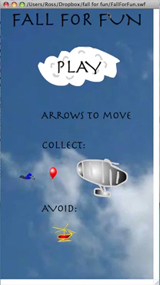
Here is clip of in game action!

Slide 9
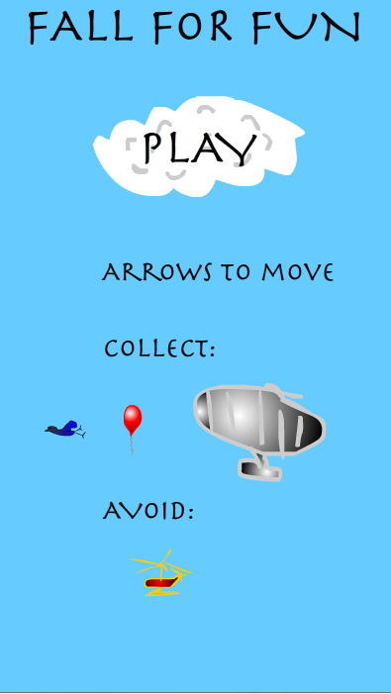
And that’s Fall for Fun.
Thanks for listening, cheers.

